Slide 1
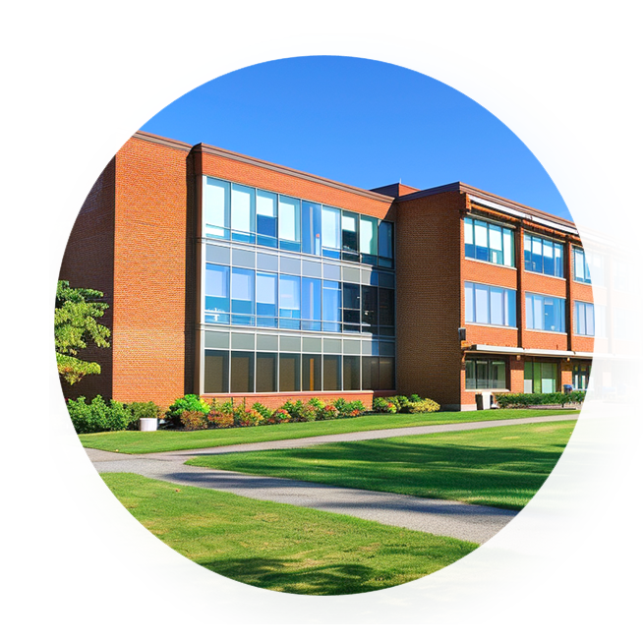
15.05.2025
Computing Components of Google Cloud Platform for Cloud Computing
Presenting By
Santhosh HG

Slide 2
Contents
1.
Introduction to Google Cloud Platform (GCP)
2.
Key Computing Components in GCP
3.
Big Data and Machine Learning Integration
4.
Networking and Resource Management
5.
Conclusion

Slide 3

01
Introduction to Google Cloud Platform (GCP)
PART 01

Slide 4


Overview of Cloud Computing
Definition and Benefits
Market Leaders and Trends
Cloud computing enables on- demand access to computing resources over the internet, facilitating cost savings, flexibility, disaster recovery, and seamless collaboration.
Major players like AWS, Microsoft Azure, and Google Cloud dominate the market, with increasing trends in AI, machine learning, and hybrid cloud strategies shaping the future.
01
02

Slide 5

Features of Google Cloud Platform
Scalability and Flexibility
Security and Compliance
GCP allows businesses to scale resources up or down based on current needs, optimizing performance and cost efficiency without long- term commitments.
The platform offers robust security measures and compliance certifications, ensuring data protection and meeting regulatory requirements for various industries.

Slide 6
02
Key Computing Components in GCP
PART 02

Slide 7



Google Compute Engine (GCE)
Virtual Machines (VMs)
Load Balancing and Autoscaling
Virtual Machines in GCE provide scalable computing resources in which users can run applications. They offer custom configurations including CPU, memory, and storage options to meet diverse workloads.
GCE includes load balancing to distribute incoming traffic across multiple instances, enhancing availability. Autoscaling adjusts the number of running instances automatically based on traffic demands, optimizing resource utilization.

Slide 8


Google Kubernetes Engine (GKE)
Container Orchestration
Integration with CI/CD Pipelines
GKE automates the deployment, scaling, and management of containerized applications using Kubernetes. It simplifies application management by handling container networking and service discovery.
GKE integrates seamlessly with Continuous Integration and Continuous Deployment (CI/CD) pipelines, allowing developers to automate testing and deployment processes for containerized applications, enhancing productivity and efficiency.

Slide 9
App Engine
01
Platform as a Service (PaaS) Overview
02
Developing and Deploying Applications
App Engine is a fully managed PaaS that allows developers to build and deploy applications without managing the underlying infrastructure. It supports several programming languages and frameworks, streamlining the development process.
Developers can quickly build and deploy applications on App Engine using built- in services such as data storage, user authentication, and monitoring tools, enabling rapid development cycles and easy updates.

Slide 10
03
Big Data and Machine Learning Integration
PART 03

Slide 11
Processing Data with Google Cloud Dataflow
Stream and Batch Processing
Apache Beam Support
Dataflow allows users to handle both streaming and batch data seamlessly, enabling real- time analytics and historical data processing through a unified programming model and simplified pipeline management.
Google Cloud Dataflow supports Apache Beam, an open- source framework that simplifies data processing by allowing users to write their pipelines once and execute them across different environments, enhancing portability and flexibility.

Slide 12


Machine Learning with Google AI Platform
01
02
Training and Deployment
Integration with TensorFlow and Other Tools
Google AI Platform facilitates streamlined model training and deployment, offering a suite of tools for experimenting, scaling, and managing machine learning workflows effectively, optimizing productivity for data scientists.
The AI Platform provides native integration with TensorFlow, enhancing the ease of use for building complex models, as well as compatibility with other popular machine learning frameworks, fostering a collaborative development environment.

Slide 13
04
Networking and Resource Management
PART 4

Slide 14



Virtual Private Cloud (VPC)
Network Design Basics
A foundational understanding of VPC architecture, including subnets, IP addressing, and routing considerations essential for creating efficient and secure cloud networks.
Firewalls and Security Rules
An exploration of how to implement firewalls within a VPC, focusing on security rules that govern traffic flow and protect resources from unauthorized access.

Slide 15
Monitoring and Management Tools
Google Cloud Operations Suite
Resource Management and Billing
An overview of Google Cloud Operations Suite as a comprehensive platform for monitoring, logging, and maintaining the performance and reliability of cloud resources.
Insights into effectively managing cloud resources and understanding billing practices to optimize costs, budget forecasting, and track usage across various services.

Slide 16
05
Conclusion
PART 5

Slide 17


Future of Cloud Computing with GCP
01.
Emerging Technologies
Emerging technologies such as AI, machine learning, and the Internet of Things are reshaping cloud computing. GCP is integrating these innovations to enhance user experiences and operational efficiencies.
02.
GCP’s Competitive Advantages
GCP offers superior scalability, advanced data analytics capabilities, and strong security measures, making it an appealing choice for businesses looking to leverage cloud solutions for growth and innovation.

Slide 18
Thanks
by SANTHOSH H G
VI Sem CSE – AIML
USN: 4VV23CI703

